Slide 1

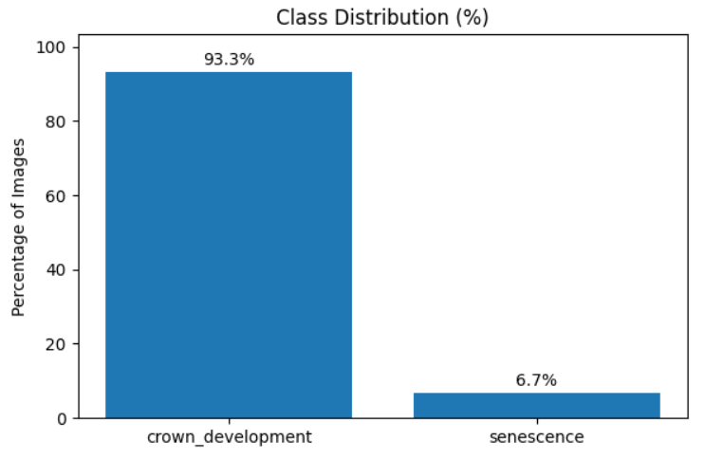
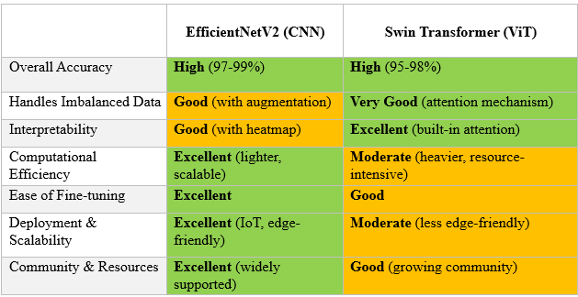


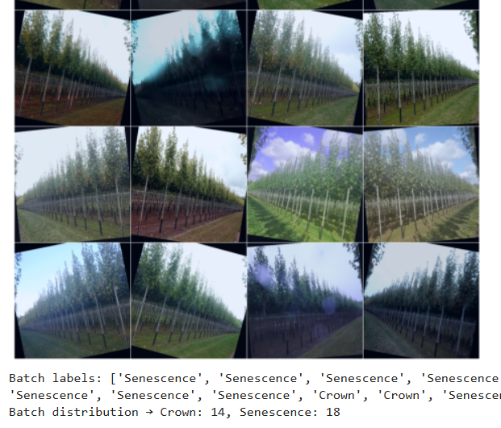
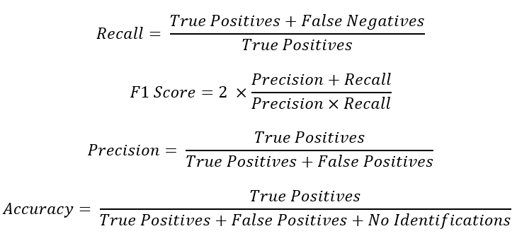


Tree Health Monitoring Using Deep Learning:
A Comparative Study of Models for Imbalanced Environmental Data
Momchil Valkov
Marcel Steegh | Dr. Andrew Hirons
Univia
GOAL
DATA
MODELS
This project aims to automate the classification of tree health using deep learning, replacing the slow and time-consuming manual inspections. By using image data collected from a tree nursery in the UK, the system seeks to detect early signs of decline and stress in real time. Automating this process can enable faster intervention, support urban environmental resilience, and provide valuable insights into tree health over time.
The dataset used in this project originates from a real-world case study provided by Dr. Andrew Hirons at Myerscough College, UK.
It contains over 5,200 RGB images of Acer and Liquidambar trees, collected over a full seasonal cycle using a fixed on-site camera system. Each image is labeled with one of five phenological stages: Dormancy, Leaf Flushing, Crown Development, Pruning Event, and Senescence.
Following models were selected for this project due to their strong performance in imbalanced classification tasks.
❖ EfficientNetV2 - high accuracy with efficient computation
❖ Swin Transformer - strong global context modeling through attention mechanisms.
PROBLEM
Tree health monitoring is traditionally a manual task, that cannot keep up with the dynamic nature of plant conditions. By the time a tree is assessed, its health may have already declined further, making timely intervention difficult or ineffective:
❖ Manual inspection is slow and not scalable
❖ Delayed detection reduces opportunities for timely intervention
❖ No automated use of available visual data
❖ Lack of accessible AI tools for non-technical stakeholders
METHODOLOGY
Table | Model’s Comparison
To address the problem of delayed and inconsistent tree health monitoring, the following methods were used: ❖ Data analysis and cleaning ❖ Preprocessing (normalization, resizing, and data augmentation) ❖ Class imbalance handling strategies (oversampling and class weighting) ❖ Training on EfficientNetV2 and Swin Transformer ❖ Evaluation using precision, recall, F1-score and accuracy
Figure | Class distribution
NEXT STEPS
In the original dataset, where some phenological stages represented less than 1% of the total samples. The task was scope down to: Crown Development (healthy) and Senescence (unhealthy). Only images of Acer trees were retained, as the Liquidambar samples contained too few instances of senescence and differed visually in structure and framing.
After filtering, a total of 1,667 images remained.
Models Training on the dataset using consistent experimental settings.
Compare the results based primarily on recall, to assess their ability to correctly detect unhealthy trees.
Design and implement a user-friendly dashboard to visualize tree health predictions, including class outputs.
Figure | Batch distribution
https://view.officeapps.live.com/op/view.aspx?src=https%3A%2F%2Fraw.githubusercontent.com%2Fvalkov01%2FTreeVid%2Frefs%2Fheads%2Fmain%2FMidterm%2520Poster.pptx&wdOrigin=BROWSELINK

